Slide 1
New Perspectives on Microsoft Excel 2019

Slide 2
Formatting Workbook Text and Data
Module 2

Slide 3
Objectives, Part 1
Change fonts, font style, and font color
Add fill colors and a background image
Create formulas to calculate sales data
Format numbers as currency and percentages
Format dates and times
Align, indent, and rotate cell contents
Merge a group of cells

Slide 4
Objectives, Part 2
Use the AVERAGE function
Apply cell styles
Copy and paste formats with the Format Painter
Find and replace text and formatting
Change workbook themes
Highlight cells with conditional formats
Format a worksheet for printing

Slide 5
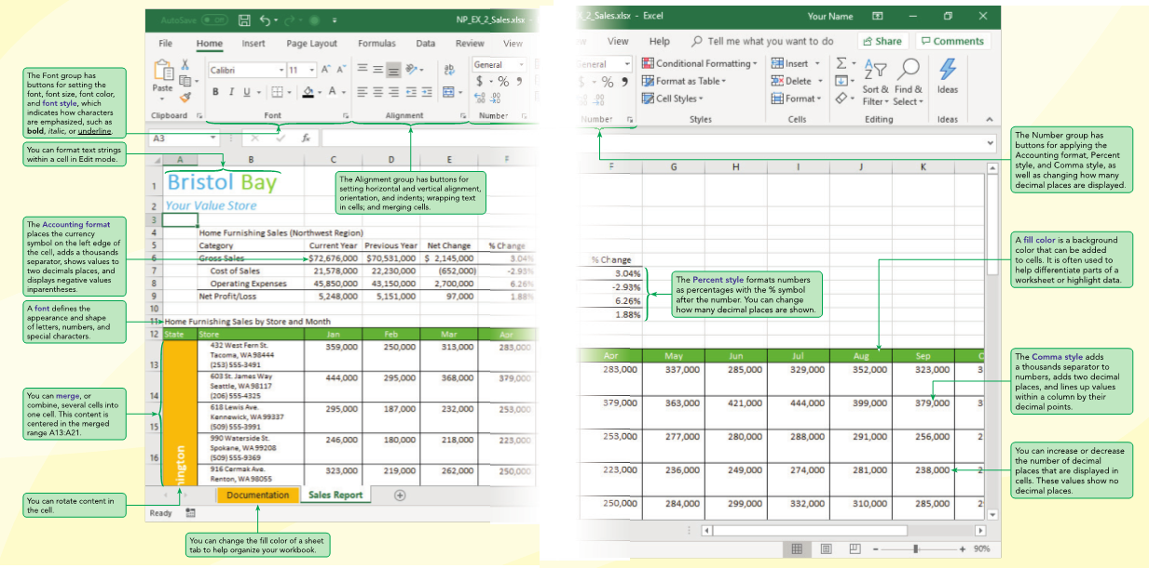
Visual Overview Worksheet with Formatting

Slide 6
Formatting Cell Text, Part 1
You can add formatting to a workbook by choosing its fonts, styles, colors, and decorative features through the use of themes
A theme is a predefined coordinated set of colors, fonts, graphical effects, and other formats that can be applied to workbooks to give them a consistent, professional look

Slide 7
Formatting Cell Text, Part 2
To choose the font typeface, select the cell or range. On the Home tab, in the Font group, click the Font arrow, and then select a font name
To set the font size, select the cell or range. On the Home tab, in the Font group, click the Font Size arrow, and then select a size
To set the font style, select the cell or range. On the Home tab, in the Font group, click the Bold, Italic, or Underline button; or press CTRL+B, CTRL+I, or CTRL+U

Slide 8
Formatting Cell Text, Part 3
To set the font color, select the cell or range. On the Home tab, in the Font group, click the Font Color arrow, and then select a color
To format a text selection, double-click the cell to enter Edit mode, select the text to format, change the font, size, style, or color, and then press ENTER

Slide 9
Applying Fonts and Font Styles, Part 1
Theme font
Associated with a particular theme
Used for headings and body text
Change automatically when you change the theme applied to the workbook
Text formatted with a non-theme font retains its appearance no matter what theme is used with the workbook

Slide 10
Applying Fonts and Font Styles, Part 2
Character styles
Serif fonts have extra strokes at the end of each character
Sans serif fonts do not have extra strokes
Every font can be further formatted with:
A font style such as italic, bold, or bold italic
Underline
Special effects such as strikethrough and color
Can increase or decrease the font size

Slide 11
Applying Fonts and Font Styles, Part 3

Slide 12
Applying a Font Color
Theme colors are the 12 colors that belong to the workbook’s theme: 4 for text and backgrounds, 6 for accents and highlights, and 2 for hyperlinks
Standard colors are always available
Can also create custom colors

Slide 13
Formatting Text Selections Within a Cell
The Mini toolbar contains buttons for common formatting options used for the selection

Slide 14
Working with Fill Colors and Backgrounds, Part 1
Filling a cell’s background with color, also known as a fill color, can be helpful for highlighting data, differentiating parts of a worksheet, or adding visual interest to a report
The same selection of colors used to change the color of cell text can be used to change the cell background

Slide 15
Working with Fill Colors and Backgrounds, Part 2

Slide 16
Adding a Background Image
Another way to add visual interest to worksheets is with a background image
Many background images are based on textures such as granite, wood, or fibered paper
The image does not need to match the size of the worksheet. Instead, a smaller image can be repeated until it fills the entire sheet
Background images do not affect any cell’s format or content. Fill colors added to cells appear on top of the image, covering that portion of the image

Slide 17
Using Functions and Formulas with Sales Data, Part 1
In Excel, you can collet sales data such as:
Gross Sales
Cost of Sales
Operating Expenses
Net Profit/Loss
Items Sold
Sales data can be used to calculate sales statistics for an entire company or specific stores and products

Slide 18
Using Functions and Formulas with Sales Data, Part 2

Slide 19
Applying Number Formats, Part 1
General format displays numbers exactly as they are typed
Some numbers may require formatting to make interpretation easier; you might need to:
Change the number of digits displayed to the right of the decimal point
Add commas to separate thousands in large numbers
Include currency symbols to numbers to identify the monetary unit being used
Identify percentages using the % symbol

Slide 20
Applying Number Formats, Part 2
Excel supports two monetary formats
Currency format
Places a currency symbol left of the first digit
Displays negative numbers with a negative sign
Accounting format
Fixes a currency symbol at the left edge of the column
Displays negative numbers within parentheses
Displays zero values with a dash
Slightly indents values from the right edge

Slide 21
Applying Number Formats, Part 3

Slide 22
Formatting Dates and Times
Dates and times are stored as numbers, not as text, so you can apply different formats without affecting values
Short Date format: mm/dd/yyyy
Long Date format displays the day of the week and the full month name in addition to the day of the month and the year
Other built-in formats include formats for time in 12- or 24-hour formats

Slide 23
Formatting Worksheet Cells
Format appearance of individual cells by:
Modifying alignment of text within the cell
Indenting cell text
Adding borders of different styles and colors

Slide 24
Aligning Cell Content
Default:
Text aligned with left bottom borders
Numbers aligned with right bottom border
Buttons to set alignment options are in Alignment group on Home tab

Slide 25
Indenting Cell Content and Adding Borders to Cells
Indenting is useful for creating subsections
In common accounting practices:
A single black border appears above a subtotal
A single bottom border is added below a calculated number
A double black bottom border appears below the total

Slide 26
Merging Cells, Part 1
Retains only content (and cell reference) from upper-left cell in the range
Merge options:
Merge & Center—merges the range into one cell and horizontally centers the content
Merge Across—merges each row in the selected range across the columns in the range
Merge Cells—merges the range into a single cell, but does not horizontally center the cell content
Unmerge Cells—reverses a merge, returning the merged cell to a range of individual cells

Slide 27
Merging Cells, Part 2

Slide 28
Rotating Cell Contents
Text and numbers are displayed horizontally within cells. However, you can rotate cell text to any angle to save space or to provide visual interest to a worksheet
The state names at the bottom of the merged cells would look better and take up less room if they were rotated vertically within their cells

Slide 29
Exploring the Format Cells Dialog Box
Buttons on the Home tab provide quick access to commonly used formatting
The Format Cells dialog box provides more options for formatting selected cells; six tabs, each focusing on different options:
Number
Alignment
Font
Border
Fill
Protection

Slide 30
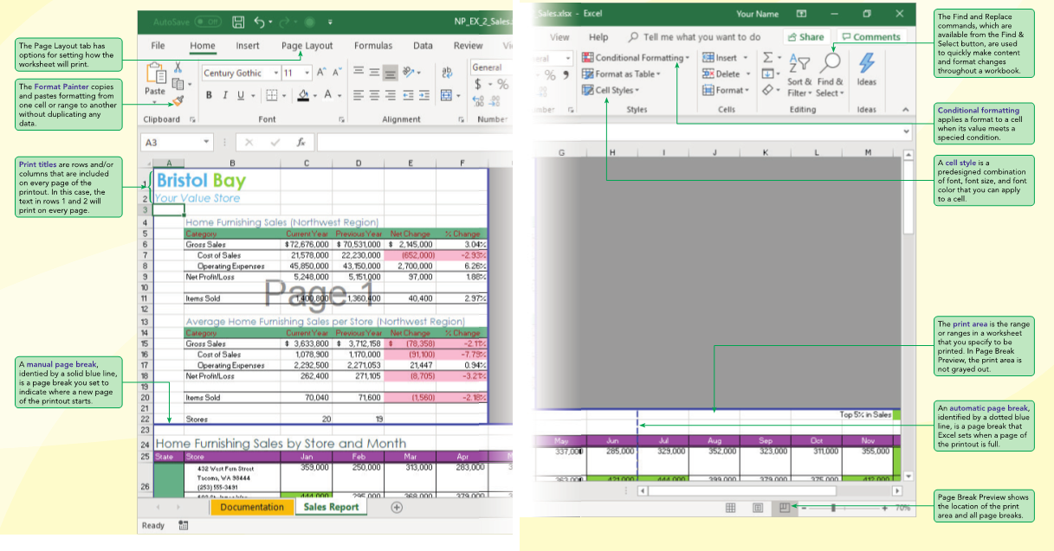
Visual Overview Worksheet Formatted for Printing

Slide 31
Calculating Averages
The AVERAGE function calculates the average value from a collection of numbers
The syntax of the Average function is:
AVERAGE (number1, number2, number3, …)

Slide 32
Applying Cell Styles, Part 1
Use styles to ensure that cells displaying same type of data use the same format
A cell style is a collection of formatting options that include a specified font, font size, font styles, font color, fill color, and borders
All cell styles are listed in the Cell Styles gallery, which you access on the Home tab in the Styles group

Slide 33
Applying Cell Styles, Part 2

Slide 34
Copying and Pasting Formats
Copying formats with the Format Painter
Fast and efficient way of maintaining a consistent look and feel throughout a workbook
Copies formatting without copying data
Use Paste Options button to paste formatting from a copied range along with its contents
Use Paste Special to control exactly how to paste the copied range

Slide 35
Finding and Replacing Text and Formats, Part 1
The Find and Replace commands let you make content and design changes to a worksheet or the entire workbook quickly
The Find command searches through the current worksheet or workbook for the content or formatting you want to locate
The Replace command then substitutes it with the new content or formatting you specify

Slide 36
Finding and Replacing Text and Formats, Part 2
You can choose to:
Find each occurrence of the search text one at a time and decide whether to replace it
Highlight all occurrences of the search text in the worksheet
Replace all occurrences at once without reviewing

Slide 37
Working with Themes, Part 1
The Office theme is the default theme applied to workbooks
When you switch to a different theme, the theme-related fonts, colors, and effects change throughout the workbook to reflect the new theme

Slide 38
Working with Themes, Part 2

Slide 39
Highlighting Cells with Conditional Formats, Part 1
Excel has four conditional formats:
Data bars
Highlighting
Color scales
Icon sets

Slide 40
Highlighting Cells with Conditional Formats, Part 2
Highlighting Cells with Conditional Formatting
Select the range in which you want to highlight cells.
On the Home tab, in the Styles group, click the Conditional Formatting button, point to Highlight Cells Rules or Top/Bottom Rules, and then click the appropriate rule.
Select the appropriate options in the dialog box.
Click OK
The Quick Analysis tool appears whenever you select a range of cells, provides access to the most common tools for data analysis and formatting of the selected range

Slide 41
Highlighting Cells with Conditional Formats, Part 3
You can modify any conditional formatting rule to change what is being formatted, as well as change what formatting is applied
You can remove a conditional format at any time without affecting the underlying data
When you use conditional formatting to highlight cells in a worksheet, the purpose of the formatting is not always immediately apparent. To ensure that everyone knows why certain cells are highlighted, you should document the meaning of the format

Slide 42
Highlighting Cells with Conditional Formats, Part 4: Figure 2-34 Highlight cells rules
Rule | Highlights Cell Values
Greater Than | Greater than a specified number
Less Than | Less than a specified number
Between | Between two specified numbers
Equal To | Equal to a specified number
Text that Contains | That contain specified text
A Date Occurring | That contain a specified date
Duplicate Values | That contain duplicate or unique values

Slide 43
Formatting a Worksheet for Printing, Part 1
Print settings can be applied to an entire workbook or to individual sheets
Page Break Preview shows only those parts of the active sheet that will print and how the content will be split across pages
By default, all cells in a worksheet containing text, formulas, or values are printed

Slide 44
Formatting a Worksheet for Printing, Part 2

Slide 45
Formatting a Worksheet for Printing, Part 3
To insert a page break:
Click the first cell below the row where you want to insert a page break, click a column heading, or click a row heading
On the Page Layout tab, in the Page Setup group, click the Breaks button, and then click Insert Page Break
To remove a page break:
Select any cell below or to the right of the page break you want to remove
On the Page Layout tab, in the Page Setup group, click the Breaks button, and then click Remove Page Break
Or In Page Break Preview, drag the page break line out of the print area

Slide 46
Formatting a Worksheet for Printing, Part 4
Add print titles (descriptive information) on each page of a printout in case pages become separated
Create page headers and footers to include text not usually found within the worksheet

Slide 47
Formatting a Worksheet for Printing, Part 5
Headers and footers have three sections: left, center, right
A margin is the space between the page content and the edges of the page
By default, Excel sets the page margins to
0.7 inch on the left and right sides
0.75 inch on the top and bottom
0.3-inch margins around the header and footer
You can reduce or increase these margins as needed by selecting predefined margin sizes or setting your own

